Slide 1
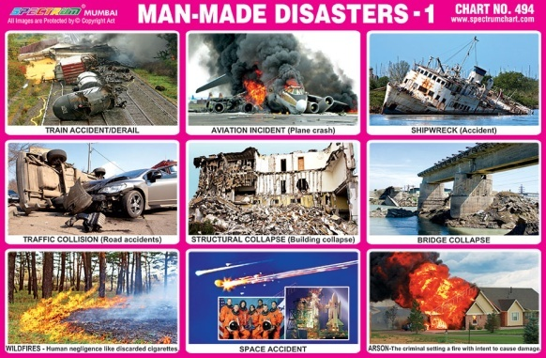
Man-made / anthropogenic disasters

Slide 2
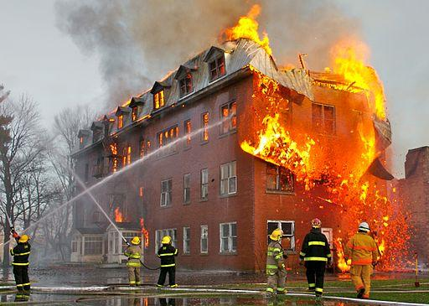
Fires
Fires in forests, homes, factories, godowns, jungles, may lead to death of many people due to burns and asphyxiation.

Slide 3
Causes
Throwing of burning match sticks on any fire catching material.
Cooking accidents gas leakage.
Short electric circuit
Waste material burnt outside roadside may catch fire.
Storage and transportation of explosive material chemical without proper precaution.
Effects
Deaths-human / livestock-injuries.
Loss of human life, plants life, buildings are destroyed, forests are destroyed.
Loss of flora and fauna.

Slide 4
Remedies—Precautions →
Don’t leave any burning material in forests or anywhere.
Be careful while cooking.
Electric wires should be checked after intervals

Slide 5
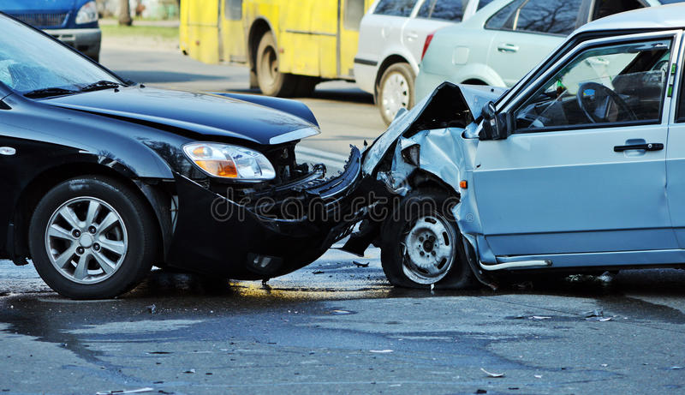
2.Road accidents and railway accidents
Road accidents

Slide 6
Causes
Small size of roads
Heavy traffic/over crowding of vehicles.
Not following traffic rules.
Driving without license.
Driving in drunken states.
Over speeding
Effects
Loss of life, vehicles etc.
Precautions→
Road size should be increased.
More roads flyovers and bypass roads should be constructed.
People should follow traffic rules.

Slide 7
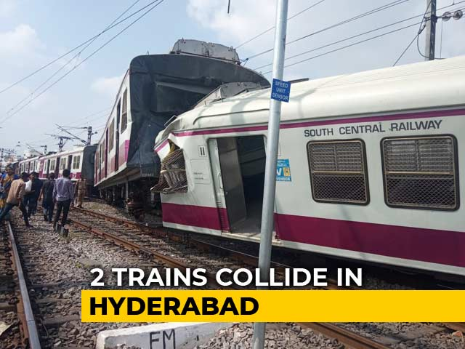
Railway Accidents

Slide 8
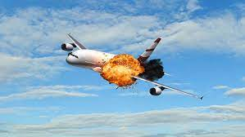
Causes
Human mistake
Damage of railway tracks due to floods, earthquakes etc.
Fire in coaches
3. Air accidents

Slide 9
Proper checking of aeroplanes before flying, Airports should be constructed away from residential areas.
Nuclear accidents, chemical spills, chemical accidents, nuclear wars, Economic collapse, Dam failure, explosion.
Biological disasters→
Epidemic, pandemic, covid 19, influenza, Dengue, HIV/Aids, flu etc.
Covid -19

Slide 10
THANK YOU

